Slide 1


Silver Airways Market Feasibility Project

Slide 2
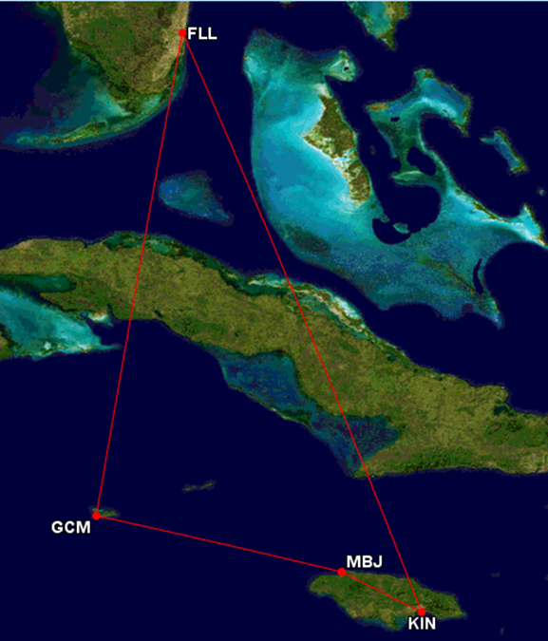
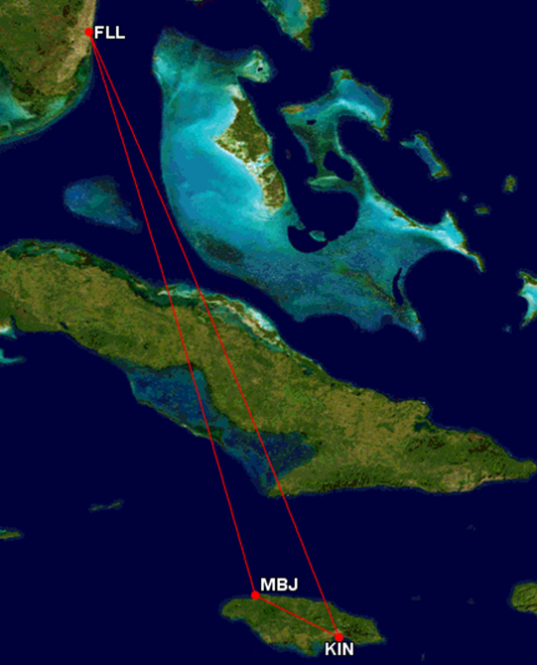
New Routes and Markets

Slide 3
Entering new markets: Jamaica and Cayman Islands
Market entry in Jamaica and Cayman Islands
  Market analysis
  Country analysis
  Economic analysis
Precautions and benefits for Silver Airlines operating business in this region.
Executive Summary

Slide 4


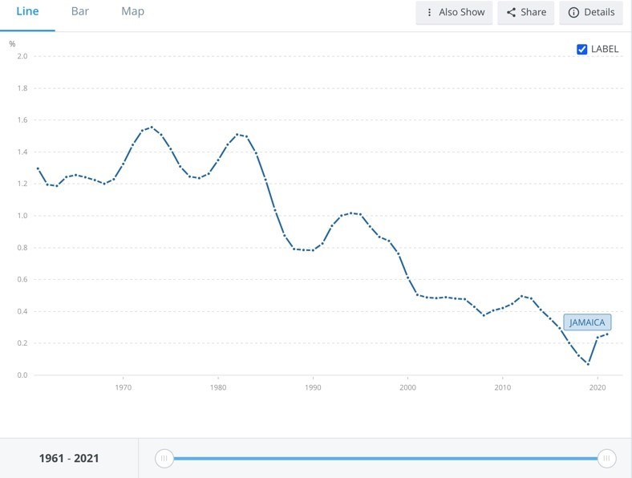
Economic Analysis – Economic Activity
Jamaica
Cayman Islands
GDP
GDP Growth
GDP Per Capita
Expanding Industries
Population
GDP
GDP Growth
GDP Per Capita
Expanding Industries
Notes:
Silver needs to look at Jamaica's GDP to project the country's national income and output.
Jamaica's GDP was worth 14.66 billion USD in 2021, with the majority coming from transportation and services, and 60% from tourism.
Jamaica has maintained a steady annual GDP growth rate for six periods in a row, expanding by 5.6% in the end of 2022.
Jamaica's GDP per capita was equal to 39% of the world's average at 4972.89 USD in 2021, which is increasing in 2022 and 2023.
The population size in Jamaica has been decreasing by less than 1% each year since 2021, and average income per person is increasing substantially.
The declining population percentages are not necessarily a bad thing as it leads to more individual income.
GDP of the Cayman Islands was 5.9 billion USD in 2021 with a growth rate of 1.8%
The GDP growth rate is faster than the population growth rate
GDP per capita is lower than 2019 but has caught up to pre-peak levels
The Cayman Islands have high industry numbers in tourism
These are good growth indicators for the economy and provide insight into consumer buying power and education levels

Slide 5
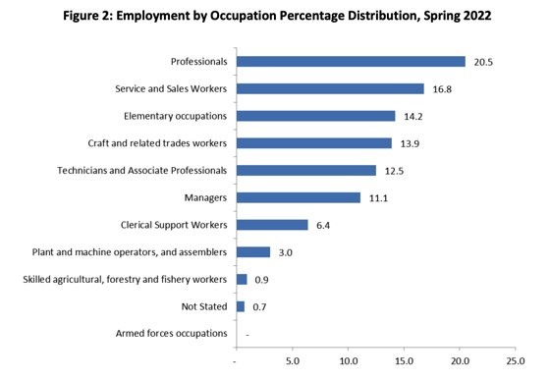
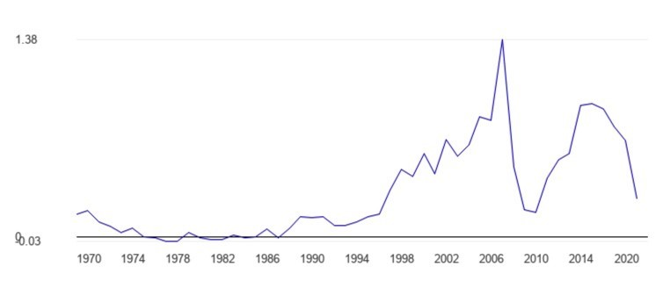
Economic Analysis – Wealth distribution
Jamaica
Cayman Islands
Tourism
  Biggest Industries
Labor Force Distribution
Financial Assistance
Movement of Labor
Labor Participation
Unemployment/ Poverty
Main Occupations
Notes:
Tourism employs 10% of Jamaica's population and contributes 60% to the country's GDP.
Jamaica could earn 2.9 billion USD in tourism alone, accommodating 2.5 million people.
Transportation and services make up 15% of the country's GDP, providing substantial income.
Employment rate was 94% in the last recorded quarter of 2022, and 64.7% of people participate in the labor force.
Jamaica's government has a CARE program to provide financial aid and incentives for companies to maintain the employment of their lower-income employees.
Cayman Islands' labor force has a large number of immigrants and locals.
More than half of the labor force is non-Caymanian workers.
There is a significant population of young people in the labor force with a youth unemployment rate of 13.8%.
The Islands reached an all-time low of unemployment levels in 2018 of 2.8%, but it has been on the rise due to pandemic and war.
Occupational percentages show a large percentage of professionals, tech associates, managers, and trade workers.

Slide 6
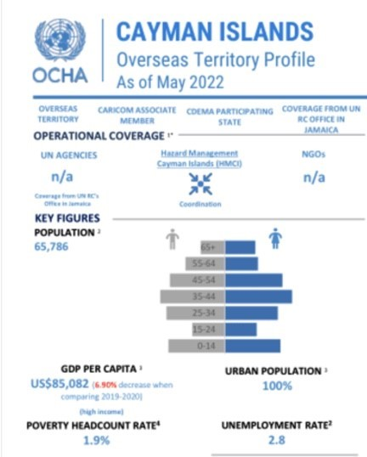
Economic Analysis
International Trade and Investment
Jamaica
  Imports/ Exports
  FDI
  Incentives to Invest
Cayman Islands
  Fiscal Policy
  Government Policy
Notes:
Exports/Imports
50% of all trading happens with the US, with major partners like Brazil, China, Turkey, and Japan.
Jamaica imports mainly refined petroleum ($366M) and crude petroleum ($273M), which are major components in the production of jet fuel.
Having this commodity easily available to Silver will be very beneficial when making a hub in Jamaica for refueling aircraft.
FDI
Jamaica is the "highest FDI destination in the English-Speaking Caribbean."
Most FDI comes from tourist and airport development, and Jamaica managed to remain the highest FDI destination despite the pandemic in 2020.
Incentives to Invest
More than 80 US firms, hundreds of US products and a million US tourists can be seen in Jamaica in 2023.
US investment is only increasing in Jamaica due to their enacted investment treaty and double taxation agreement.
Fiscal Policy
The Cayman Islands have dominant offshore banking capabilities in the Caribbean
Recent fiscal policies have been put in place to combat money laundering and tax evasion
The islands have simplicity in hedge fund financial assistance for offshoring and one of the biggest captive insurance hubs in the world
Government Policy
Department of commerce and investment has regulations and laws in place to protect the local business environment
Silver's ability to get licensing might be affected due to the Trade and Business Licensing Act, but offering to transport more people to the country could help grow the GCM airport
The Cayman government created a new division in 2012 that acts as a guide for foreign investors to operate efficiently in the economic/ social environment
Benefits of investing in the Cayman Islands include a diverse global product market, benefits to cultural/environmental health, and a trusted support group for foreign investors

Slide 7
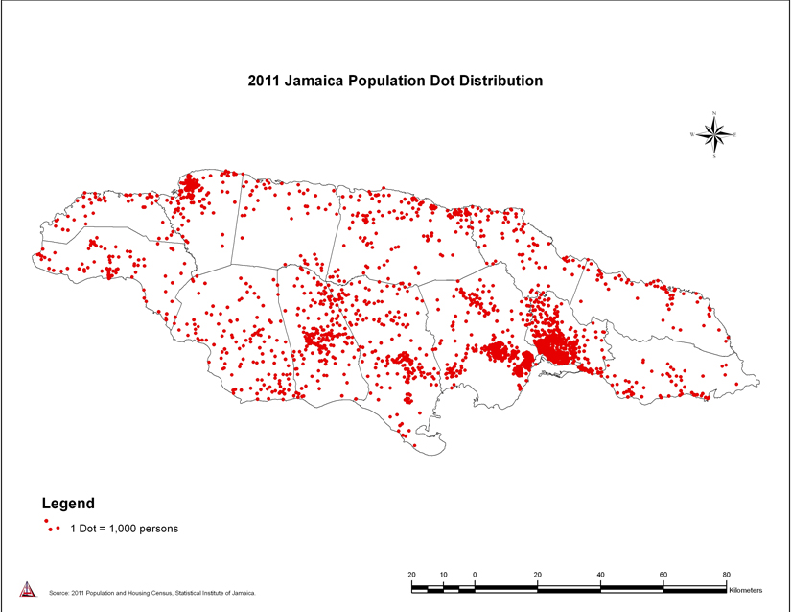
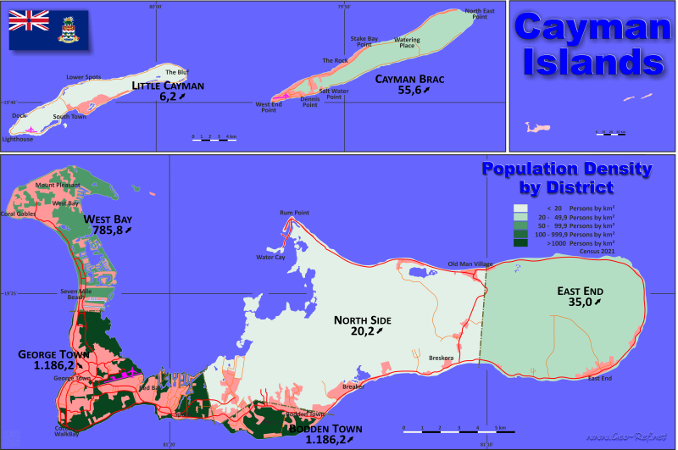
Country Analysis- Demographics & Culture
Population distribution in Jamaica and Cayman Islands
Population density (location and distance from the airport)
Literacy (Jamaica- 88.7% & Cayman Islands- 98.8%)
Religion
Culture

Slide 8
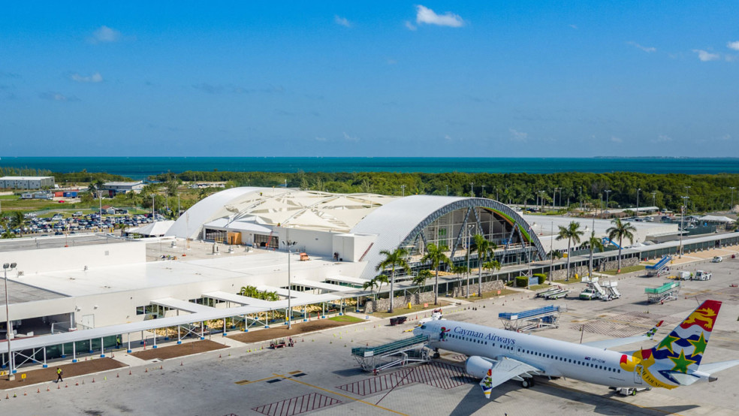


Country Analysis -Infrastructure and Technology
The Cayman Islands Infrastructure
  Health City Cayman Islands
  The Dart Group
  Owen Robers International
Technology
  "Smart Island"
Jamaican Infrastructure
  Recent developments
  Multinational companies
  Oxford
Technology
  Coding education expansion
  Connectivity
Notes:
The Cayman Islands have experienced strong growth in recent years due to infrastructure projects.
The Health City Cayman Islands, a new medical campus, was created in 2021 with a $100 million budget, featuring robotic medical science, education, and research.
The Dart Group has been prevalent in infrastructure projects since 2005, including expansions of the Cayman International School, resident living, townhouses, hotels, and tourist developments.
The Owen Roberts International airport also saw a $120 million expansion, nearly tripling its size, in order to attract new airlines and broaden its consumer demographic.
The Cayman Islands plans to create a new underwater connection to the US via fiber optics to improve communication and become a "smart Island".
The CI's established digital tech base and innovative technology teams offer opportunities for capitalizing on rapid expansion.
Jamaica's infrastructure and technology have been constantly growing in recent years.
The government has made multiple investments in raising the country's infrastructure, including roads, airports, technology, and seaports.
Recent developments in the telecommunications infrastructure include expansion of high-speed internet and power with Elon Musk's investment in Starlink SpaceX as a provider.
Jamaica has an innovative community, with young businesspeople creating efficient solutions to the country's problems.
The government has created initiatives that promote digital literacy and training in tech specialization, including free Wi-Fi in public spaces and a program to teach coding in schools.
Oxford University has significantly helped with Jamaican infrastructure in climate technology and research.
Multinational companies have established bases in Jamaica, aiding in boosting the country's technology capabilities and creating job opportunities for Jamaicans.
The future growth of Jamaica's infrastructure and technology indicates an opportunity for Silver to take advantage of the new labor force that may create new coding implementations/software for their operations.

Slide 9
Country Analysis - Geographic Considerations
Jamaica
The Greater Antilles
Centralized location
Fostering economic Growth
Gateway to Atlantic and Pacific
The Cayman Islands
Jamaica
Mountainous island
Local and International Airports
Expanding logistics industry
2nd largest US agriculture exporter in the Caribbean
The Cayman Islands
3 islands
Experience some earthquakes
Financial services hub due to centralized location
2 international airports

Slide 10
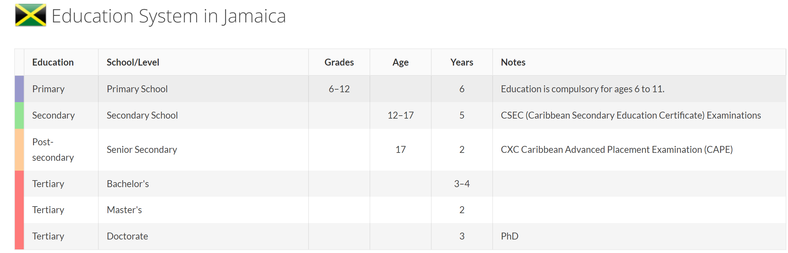
Country Analysis- Social Institutions
Jamaica
Cayman Islands
Government
  Constitutional monarchy- executive, legislature, judiciary branches (similar to British rule, US knows a lot about)
Family
  Very important, many generations in 1 household helping raise children and providing
  Make a point to eat together every Sunday
Education
  First 6 years is mandatory
  Working towards upgrading secondary school as their economy grows
Government
  Similar to Jamacia (elections every four years like the US) and legal system of English common law
Family
  Old fashioned to the US, mother expected to stay at home and raise children, slowly moving away from that with a big shift in women working and two parent having incomes
Education
  Largest government financial focus
  Compulsory to age 16 with literacy rate at 98%

Slide 11
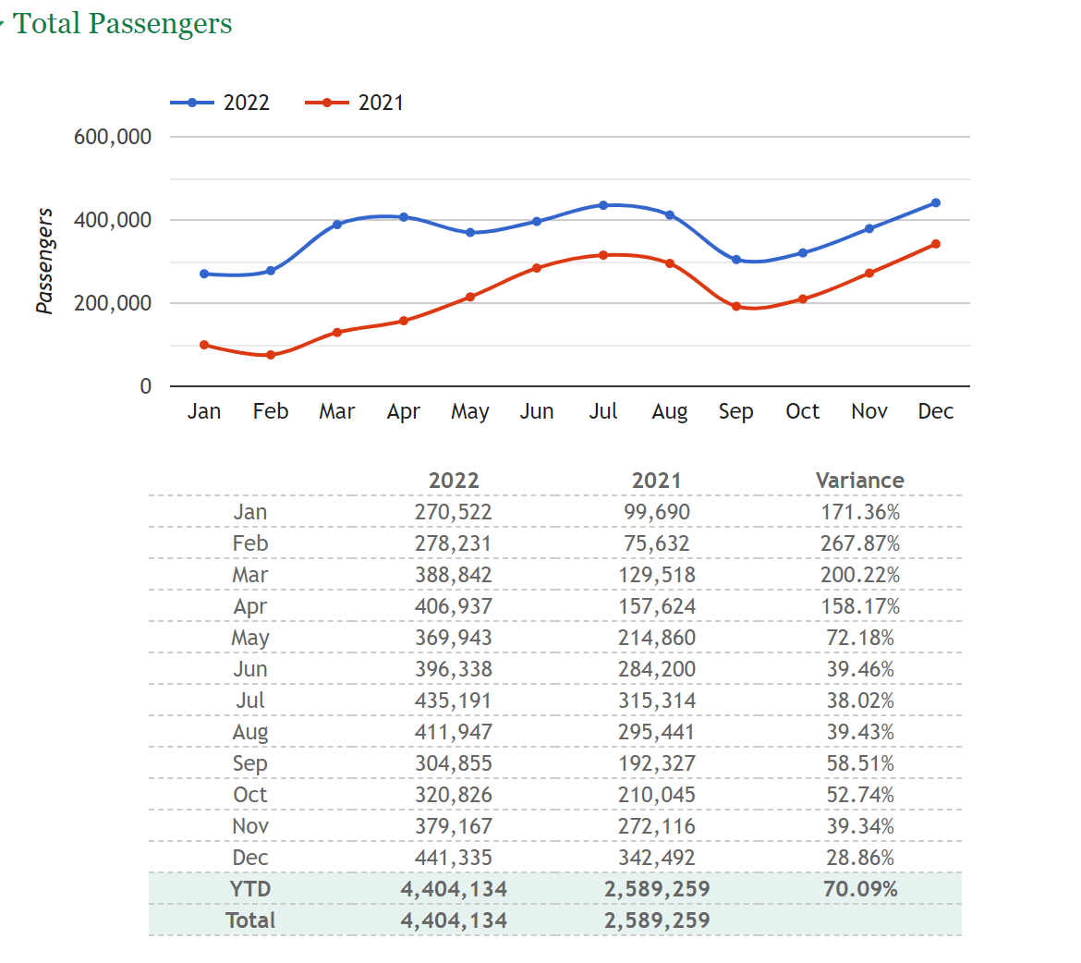
Market Analysis
Jamacia
New hub
  Bigger island
  Established area- trade with US
Tourism
  Big source of revenue for the country
Short direct flights
  Advantage for Silver
Economy
  Finances are very well maintained by the government
  More travel and customer spending
Negatives
  Off seasons
  Travel advisory (level 3), police issues
Airport
  New upgrades underway
  Established with other airlines
Passengers

Slide 12
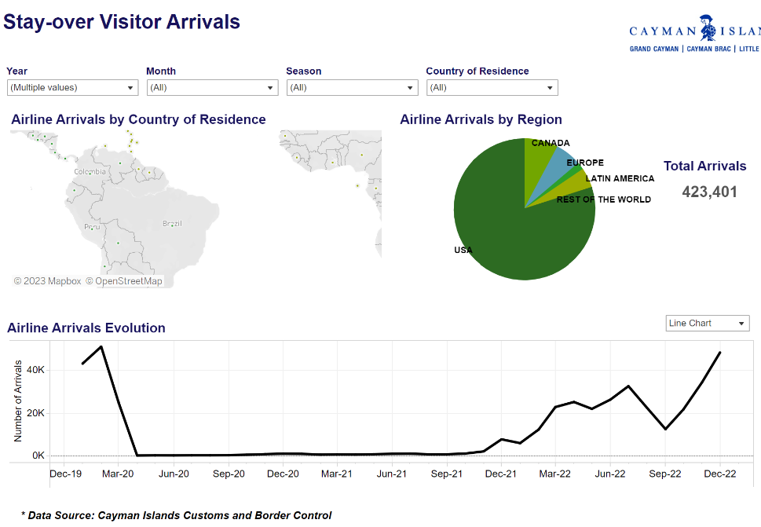
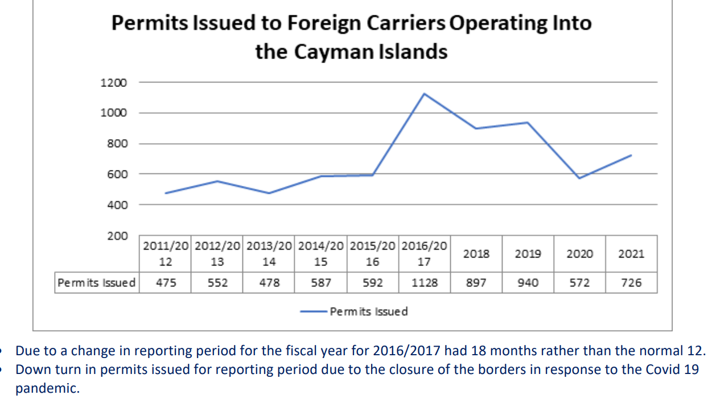
Market Analysis
Cayman Islands
Waypoint
  Connection or stop over
  Seasonal
Trade
  A lot with US
Population
  Quarter being foreign
Business and Tourism travel
  Source of income for the islands
  Focus for Silver
Airport Upgrades
  Owen Roberts International Airport
Negatives
  Travel risk (level 3)
  permits

Slide 13


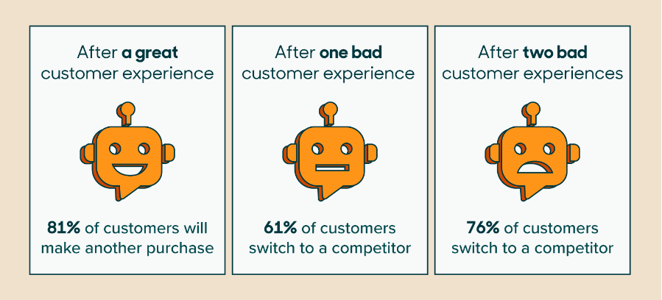

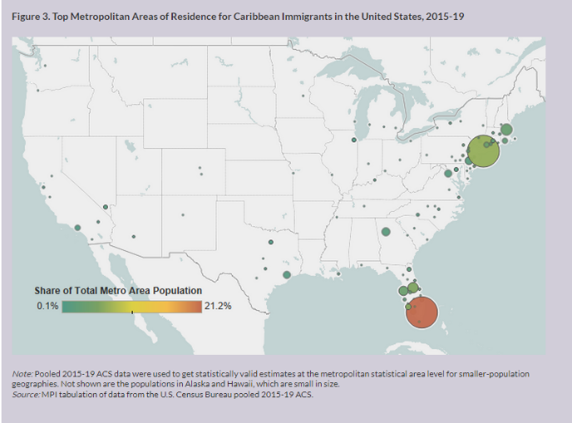

Retention, Adoption & Recognition Strategically building Brand Loyalty
Caribbean Flyers Loyalty Program
Caribbean Island Heritage Month Promotion
Jamaica
Montego Bay – Key Gateway
Kingston – Hub
The Cayman Islands
Grand Cayman
New
Strategic Locations
Customer Service
Brand Loyalty
Targeted Marketing Campaign
Differentiation

Slide 14
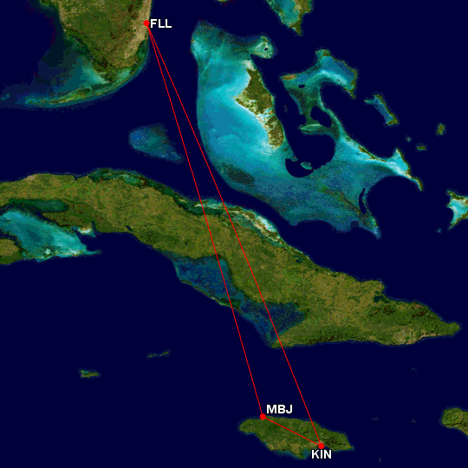


New Daily Location
Jamaica Strategy
New Key gateway in Montego Bay Jamaica
New hub in Kingston Jamaica
Each Jamaican international airports is mentioned as a top 20 international market for FLL
High Daily Round Trip Passengers volume between Fort Lauderdale and Montego Bay (233) or Kingston (291)
78% is total average load factor for airlines arriving in Jamaican airports (JSCA,2023)
New route that is inverted daily (MBJ-FLL-Kin-MBJ-FLL)/(FLL-MBJ-KIN-FLL-MBJ)
2020’s Florida Jamaican population was 245,427, an increase of 7.3% over 5 years (Name Census, 2023)
Broward and Dade Counties are top epicenters of Caribbean islanders in the US (Lorenzi and Batalova, 2022)

Slide 15


New Seasonal Location Strategy
The Cayman Islands
MBJ-GCM-FLL-KIN-MBJ
Forecasted to fully recover from Covid 19 in 2023
Established traffic
Recovery
Opportunity
Localized investments targeted at expansion of leisure travel
Abundant travel between Grand Cayman and Fort Lauderdale and Jamaica
Cayman airways record breaking month in October 2022 transporting 31,000 passengers to GCM

Slide 16
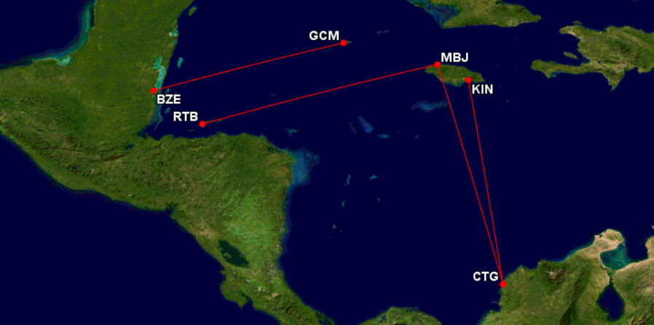

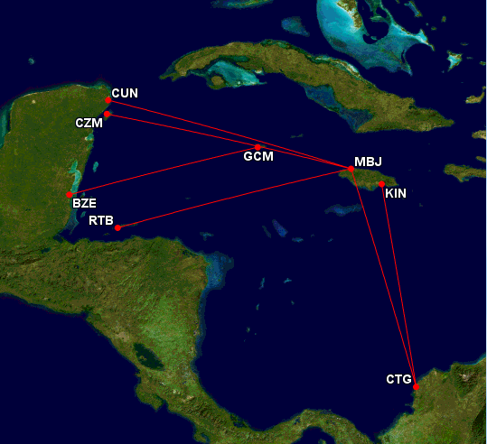
Other Strategic Insights
Further expansion opportunities in new markets & territories
  Mexico
  Northern Honduras
  Western Belize
  Norther Colombia

