Slide 1

A Cross-Coin Cryptocurrency Analysis
By Quinton Carter

Slide 2
What is Cryptocurrency?
Cryptocurrency it is a digital asset.
  It can be bought and sold online
  Transactions are validated by a chain of approvers (blockchain)
Assets are called “Coin’s”
  Does not reference their physical value
Cryptocurrency has been around for over a decade.
  Has seen exponentially high growth in the assets value.
How banks use digital currency
  Customer provides legal tender (1 dollar)
  Bank recognizes this dollar
  Bank gives the customer rights to 1 digital dollar to spend
Cryptocurrencies also includes additional features
  Instant transfer of assets
  No translation of currency
  Public visibility of all transaction

Slide 3
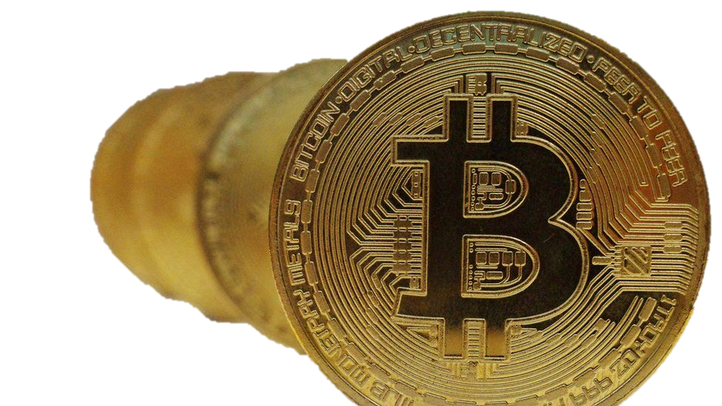
How Volatile is Cryptocurrency?
Bitcoin’s price history
2009 - Opened at $0
2010 – $0.09
2011
  April 13 2011 – $1
  3 months later
  June 7 2011 – $29.60
In the past decade
  March 2012 – $5
  March 2022 –$40,000
This increase is equivalent to
  $333 a month
  $11 each day
  Almost 1 penny an hour
Put simply very volatile. But where there is risk there is the potential for great reward.

Slide 4
Let’s talk about the assets
Bitcoin
Ethereum
Mana

Slide 5

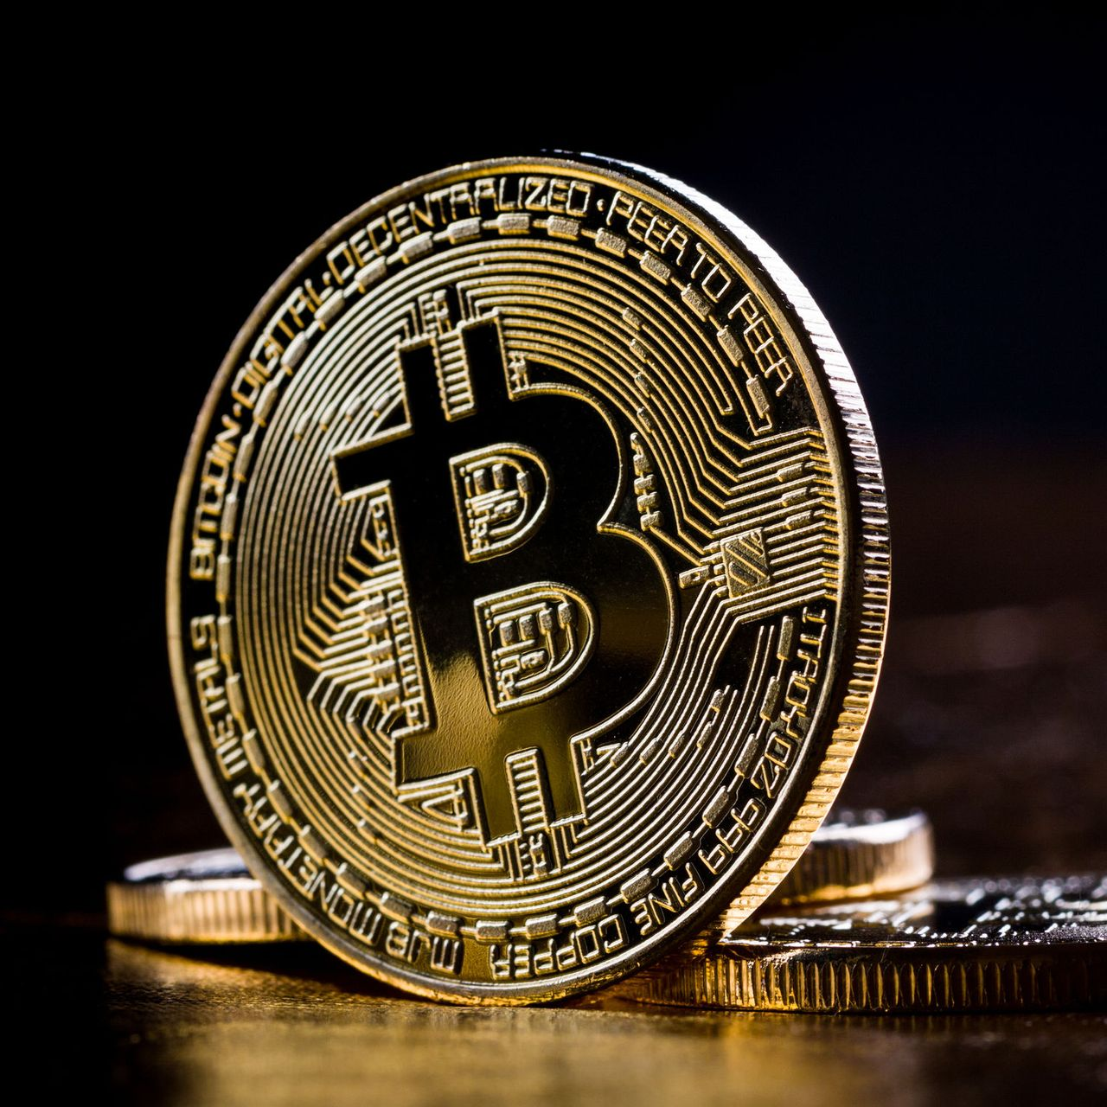
Bitcoin or BTC
Bitcoin – BTC (Gold Standard) – cost $40,000 per coin
It’s the standard because it is the oldest
  literally referred to as digital gold
  Most widely known
  Most adopted
  Most successful cryptocurrency

Slide 6
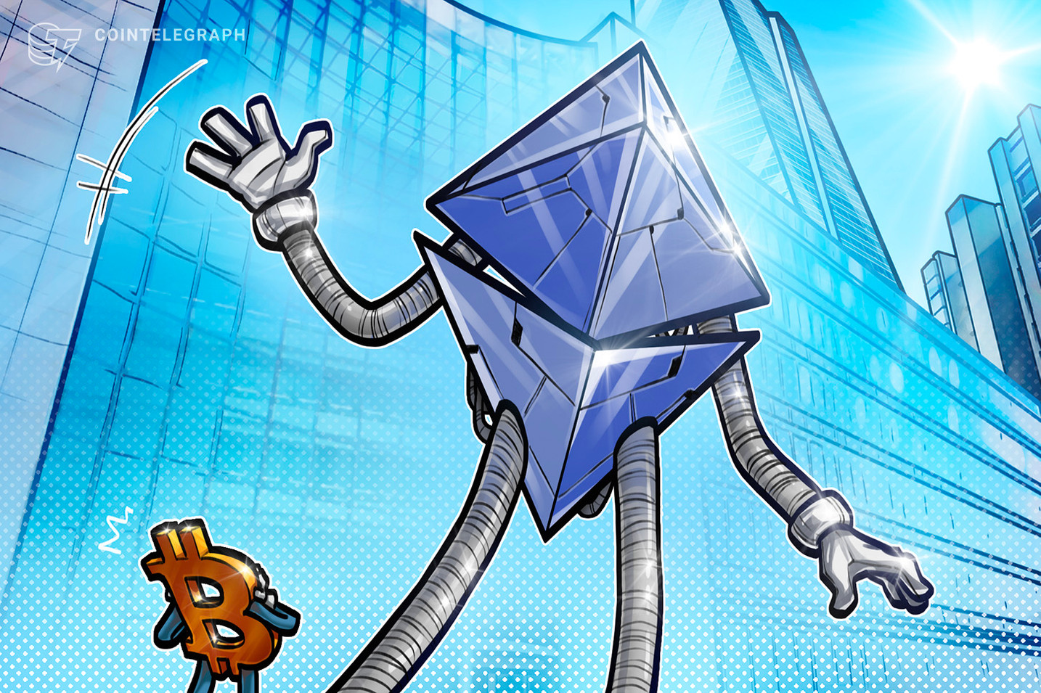
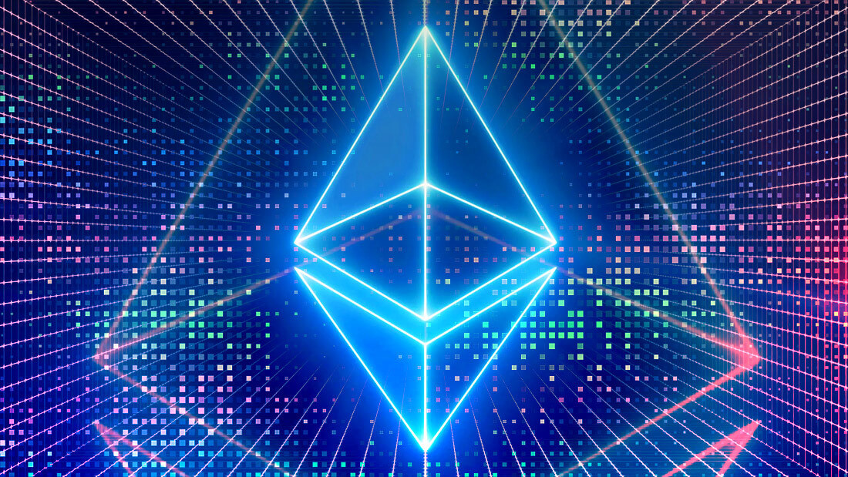
Ethereum or ETH
Ethereum – ETH – cost $3,000 per coin
It is the next generation of block chain
  Lower transaction costs
  Lower fees
  Less environmental impact
  Is as widely known as BTC.

Slide 7
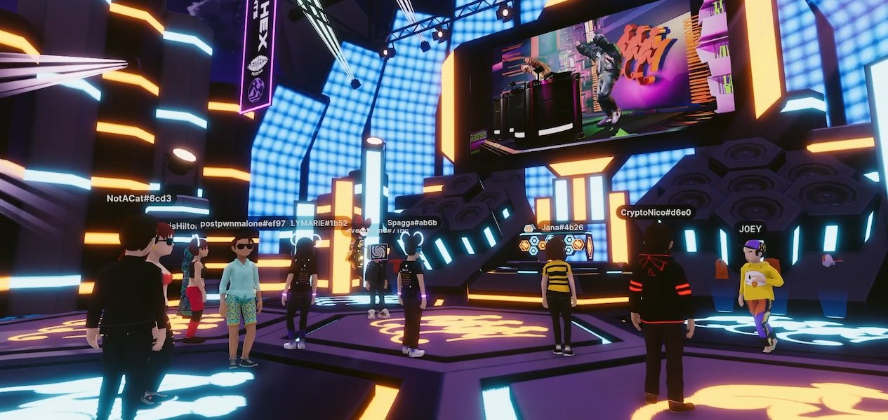
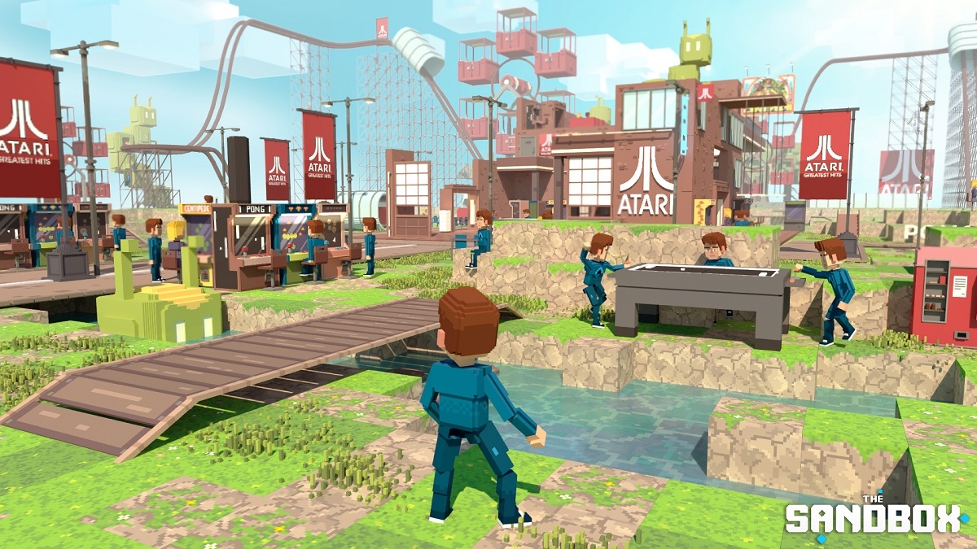
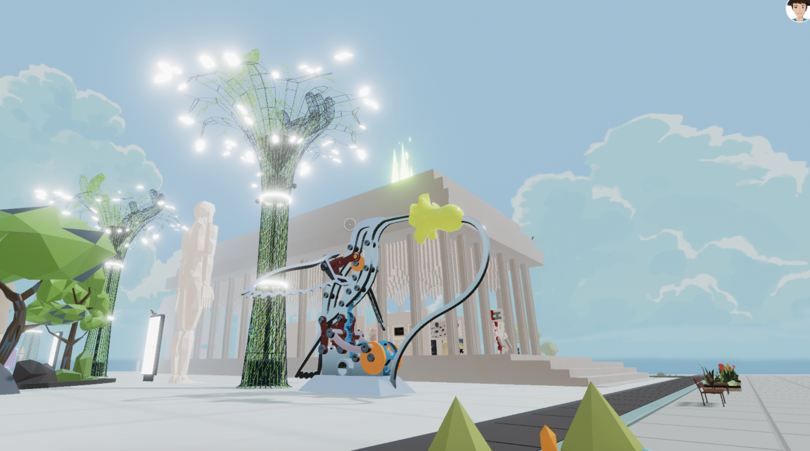

Decentraland or Mana
Decentraland – Mana – cost $3 per coin
Decentraland is a fully digital metaverse
  Most successful and widely known metaverse
    Companies that own plots - Atari, Adidas, PwC, Samsung, JP Morgan, Barbados [embassy]
  Sells digital “land parcels” as Non-Fungible Tokens
    The token gives ownership to the “land” in the Decentraland metaverse.
The land can be used for anything:
  Some examples are shown here

Slide 8
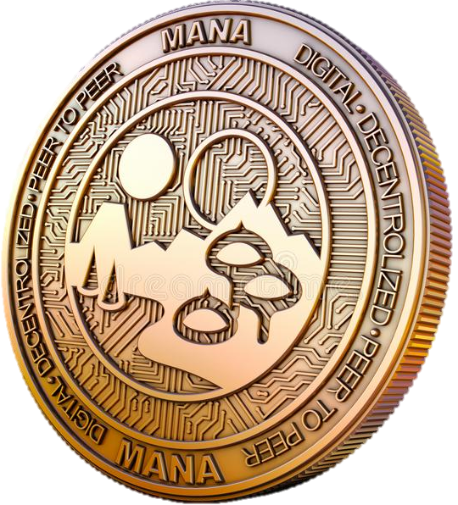
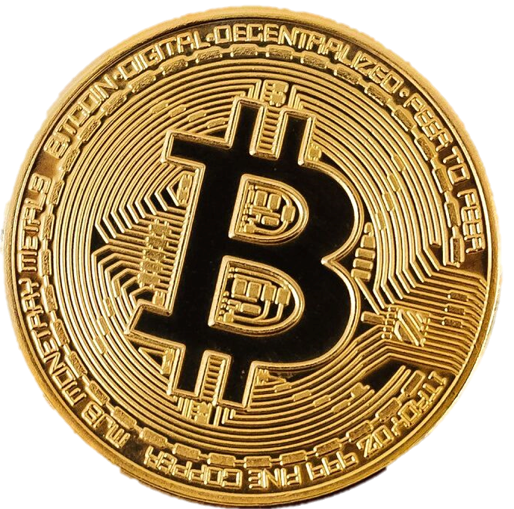
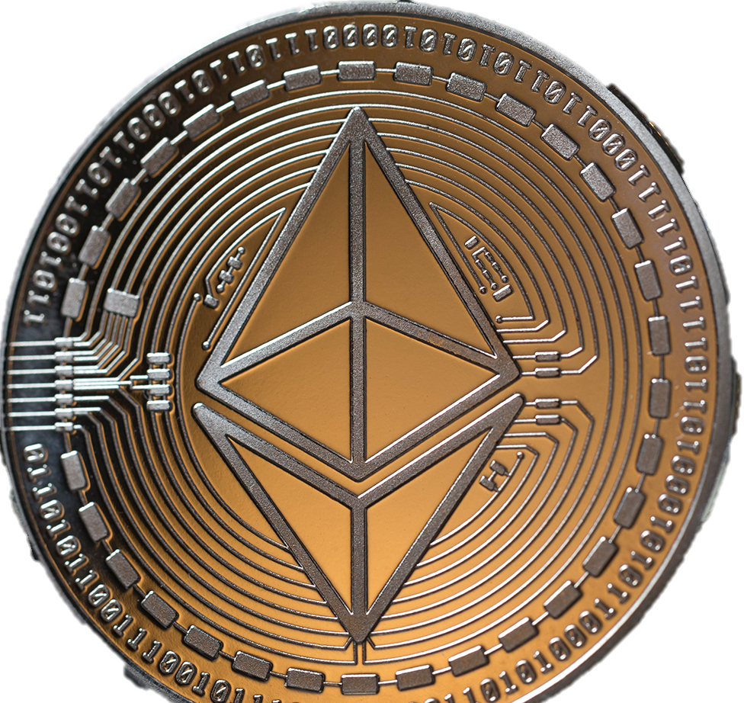
The Analysis
There will be no focus on a direct price comparison.
The analysis will explore:
Buying habits and trends
If BTC sets the tone for the whole market
Growth potential
Current market projections based off the data

Slide 9
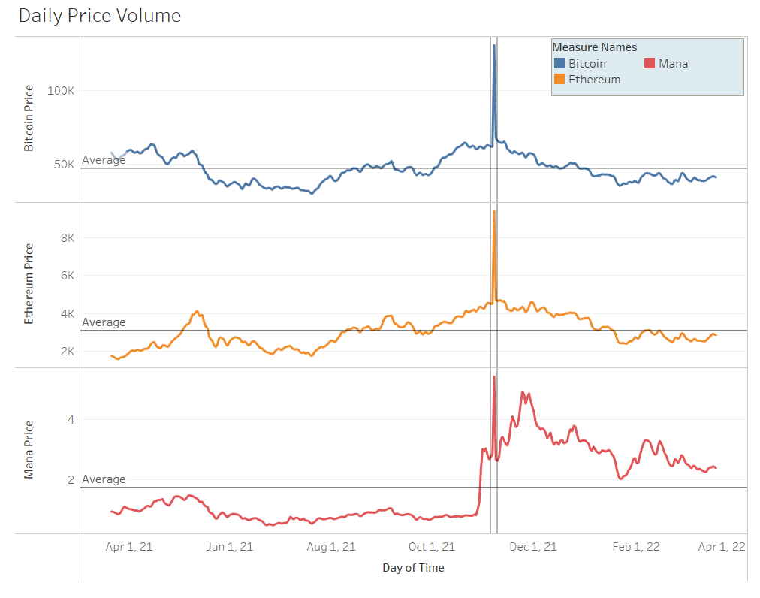
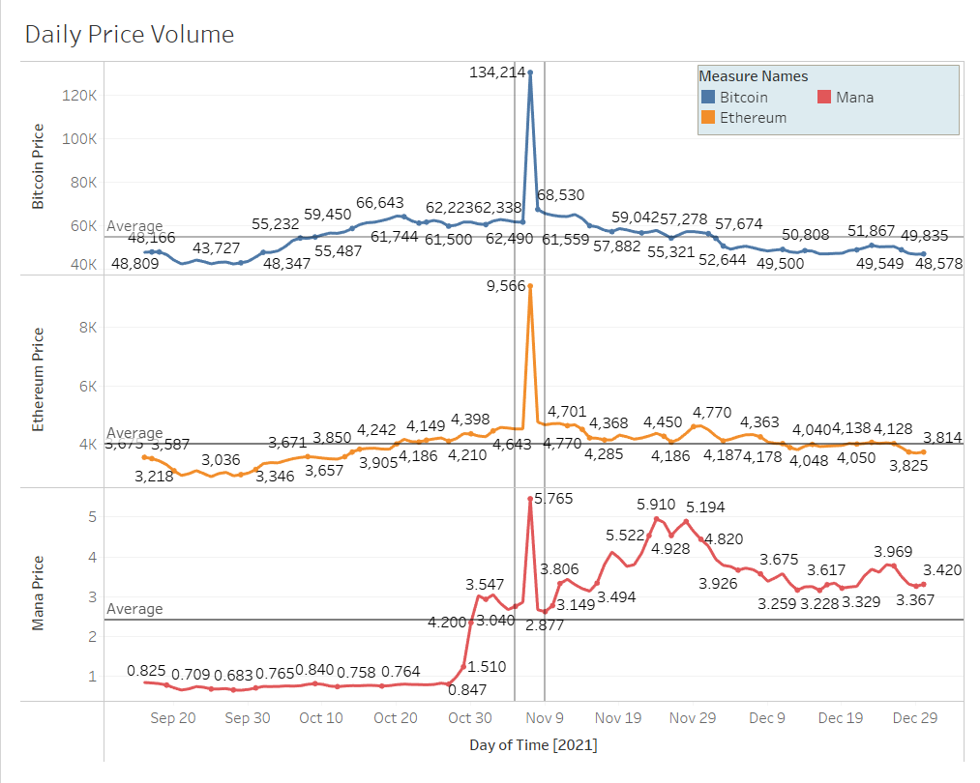
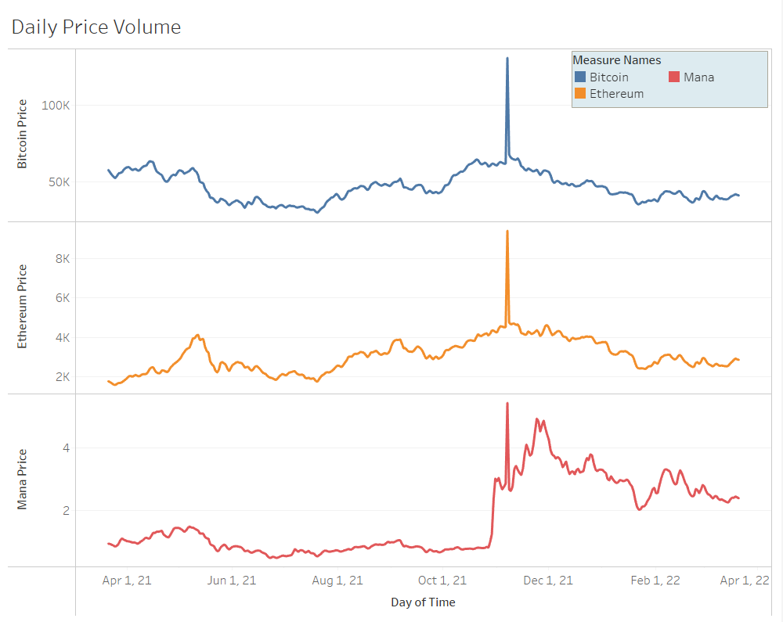
Price action in
the last 12 months
Price Irregularity November 7th, 2021
This can be excluded from the metrics as a clerical error, or corrupted data.
Besides that, the pricing data seems consistent with the market.

Slide 10
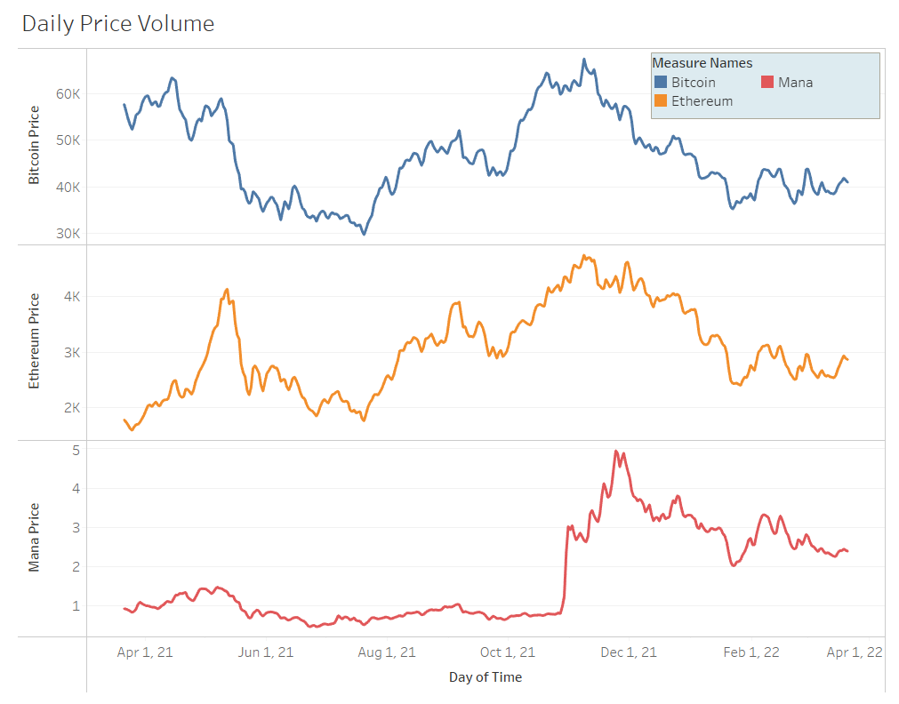
Crypto Asset Price Movement
Which asset had the greatest growth in the last 12 months?
MANA
Did any assets have any major price movement?
MANA had a substantial spike, from 10/27- 11/7 the price went from .806 to 5.46
For ETH May 2021 had a rather large spike
Contributing factors?
BTC and ETH - Volatility of Cryptocurrency, attraction of high-risk investors.
MANA - Companies buying their land parcels, wider adoption of the NFT marketplace or, in general, wider adoption of the coin

Slide 11
How far could $1,000 go?
If $1000 was invested in each on July 20th 2021, how much would that investment be worth the following year?
Asset | Cost on April 1st | Amt to spend | Amt of coins | Price 1 year later | Investment value 1 year later | Increase in value
BTC | $29730 | $1,000 | ~0.0336 | $40,970 | $1,376.592 | $376.59
ETH | $1765 | $1,000 | ~0.5665 | $2,872 | $1,626.988 | $626.99
MANA | $0.522 | $1,000 | ~1,915.7088 | $2.394 | $4,586.2069 | $3,586.21
USD (in the Bank) | $1 | $1,000 | 1,000 | $1 | $1,001 | $1

Slide 12
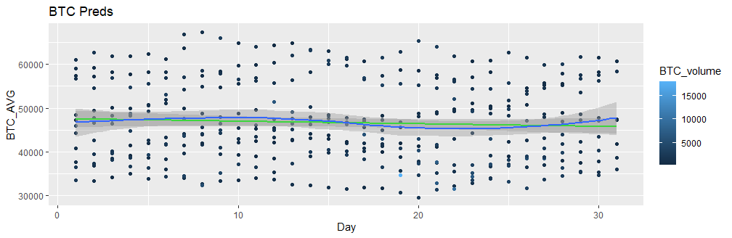
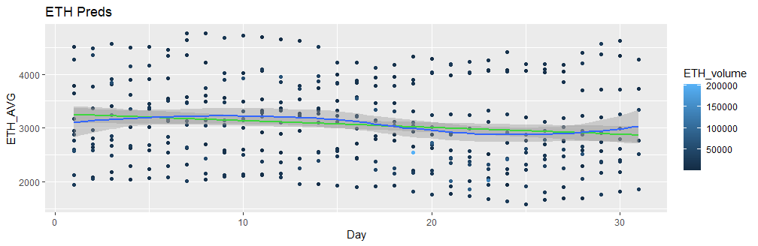
Crypto trends, day of the month

Slide 13
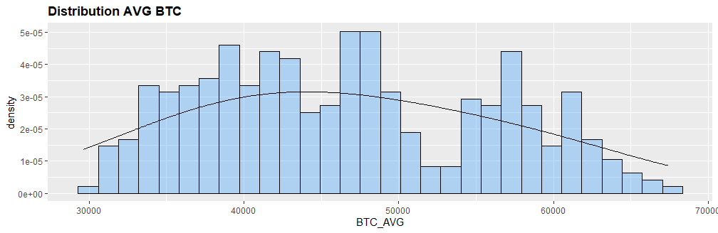
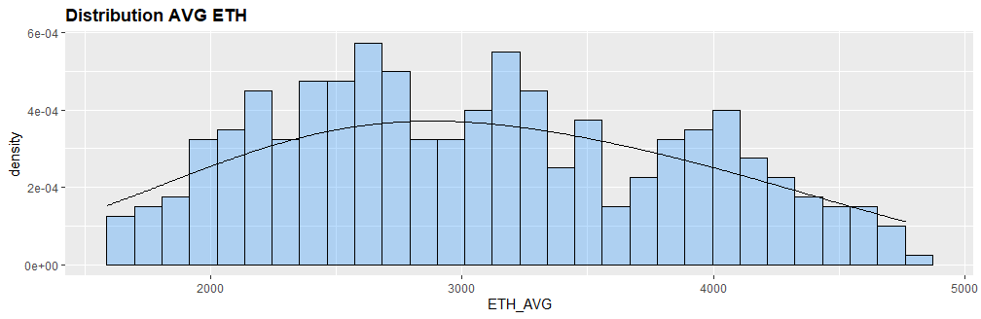
Distribution of Price Action
Peaks & Valleys will occur with any high-risk assets.
Distribution of coins prices can help us determine stability of asset and price.
Both Bitcoin and Ethereum have wide ranges.
  The appear to have good distribution.
Better the clustered distribution around the mean the higher the stability.

Slide 14
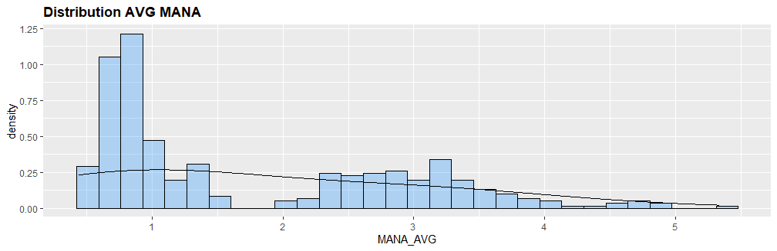
Distribution of Price Action
Mana
A mean can be determined but the distribution is too scattered for it to be identified as a stable asset
Due to the spike last November, MANA is still an extremely
high-risk bet

Slide 15
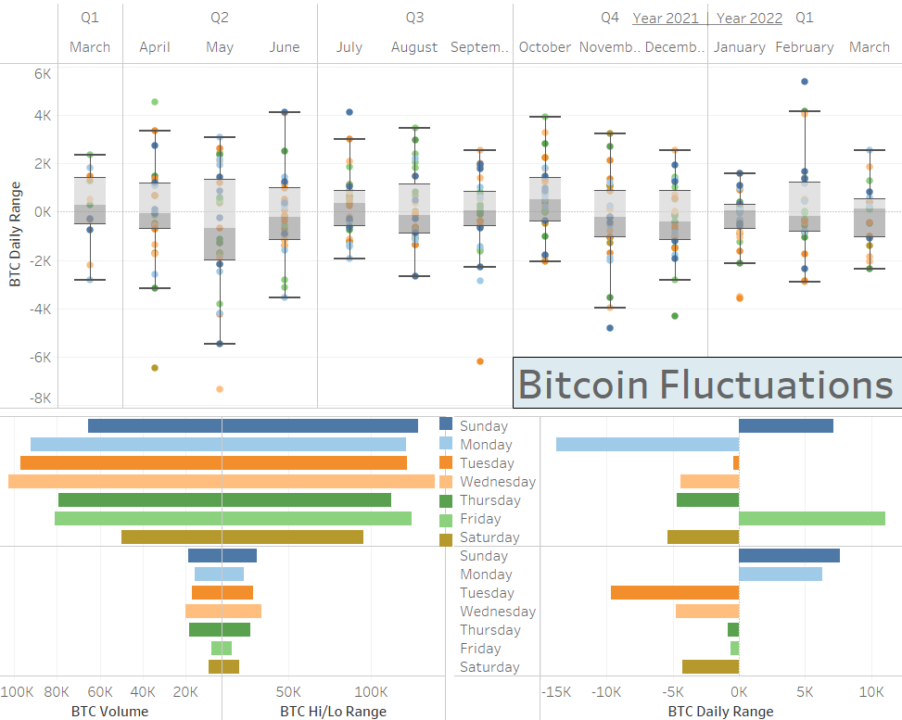
Bitcoins Values
This chart shows Bitcoin’s weekly activity.
2021
  Buy
    Sunday
    Friday
  Sell
    Monday (Big Sell)
    Wednesday, Thursday & Saturday
  Hold
    Tuesday
2022
  Buy
    Sunday & Monday
  Sell
    Tuesday (Big sell)
    Wednesday & Saturday
  Hold
    Thursday & Friday

Slide 16
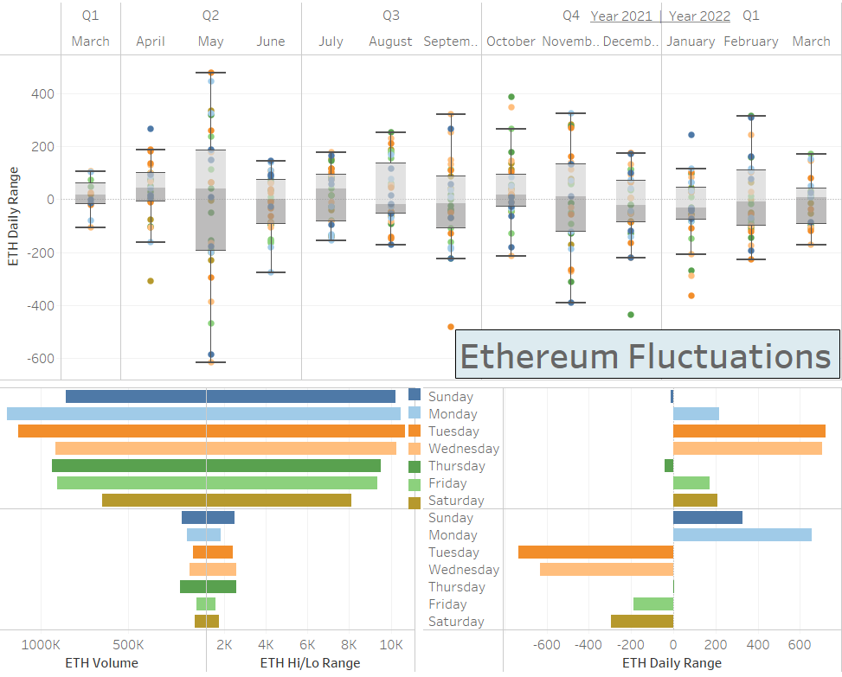
Ethereum Values
This chart shows Ethereum’s weekly activity.
2021
  Buy
    Monday, Friday & Saturday
    Tuesday & Wednesday (Big Buy)
  Sell
    Not really a good day to sell
  Hold
    Sunday & Thursday
2022
  Buy
    Sunday
    Monday (Big Buy)
  Sell
    Tuesday & Wednesday (Big sell)
    Friday & Saturday
  Hold
    Thursday

Slide 17
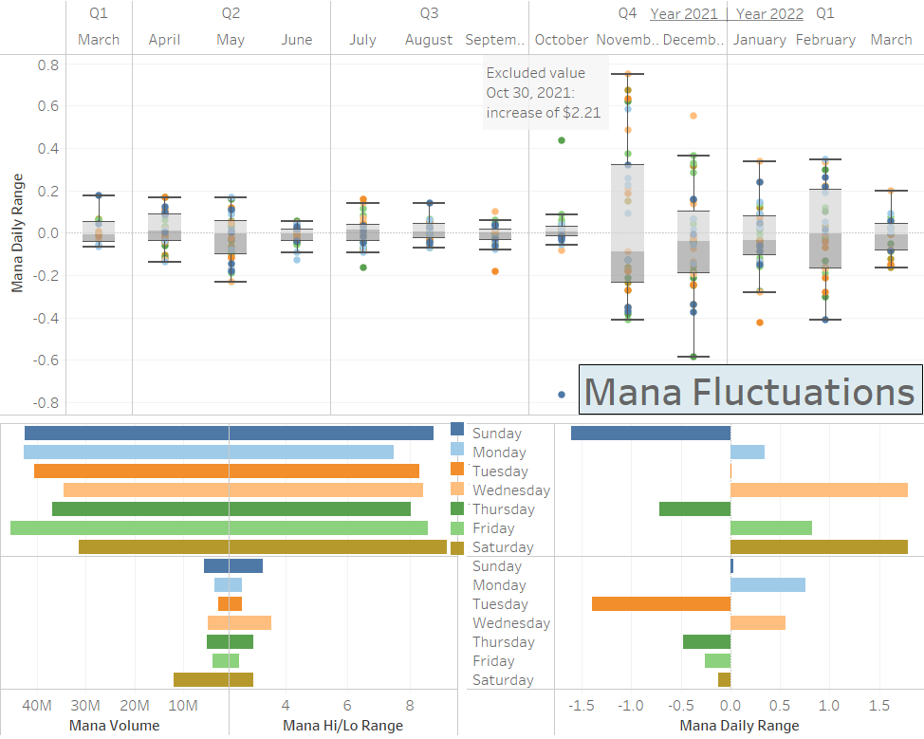
Mana Values
This chart shows Mana’s weekly activity.
2021
  Buy
    Monday & Friday
    Wednesday & Sunday(Big Buy)
  Sell
    Sunday (Big Sell)
    Thursday
  Hold
    Tuesday
2022
  Buy
    Monday & Wednesday
  Sell
    Tuesday (Big sell)
    Thursday
  Hold
    Sunday, Friday & Saturday

Slide 18
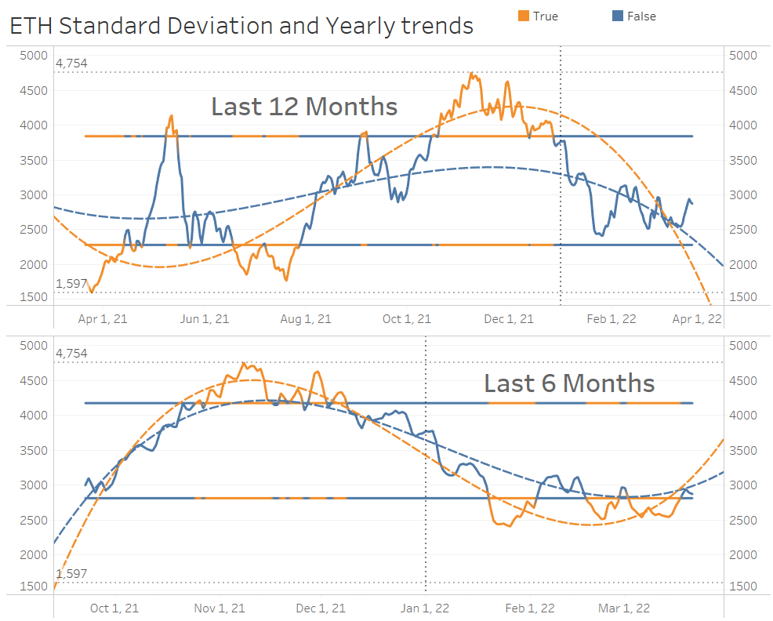
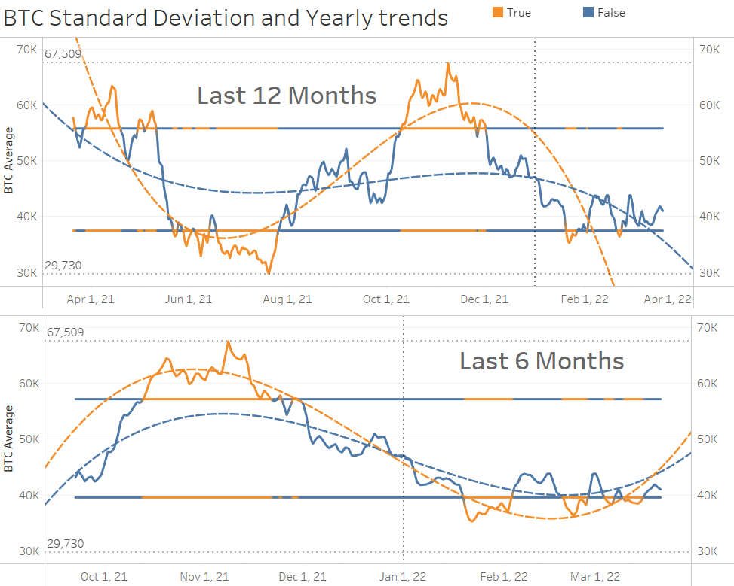
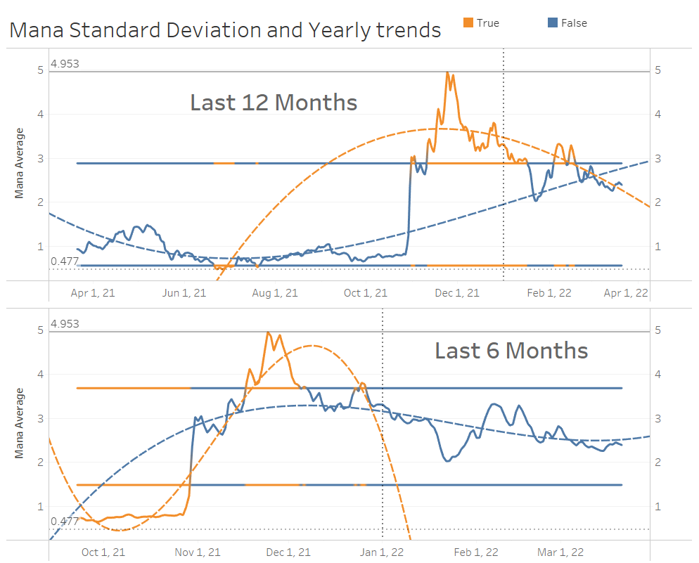
Individual Market Trends
BTC and ETH 6 month
  Good movement, potential for some positive price action ahead
Mana 6 and 12 month
  Recovering from spike
  negative price action
Overall Market trends
  Show negative future price action
BTC and ETH are on the lower end of the SD in the 6 and 12 month views
  Opportunity to purchase with lower risk
MANA is sitting at the top of 12 and middle of the 6mth.
  Still recovering from spike so greater risk for current purchase

Slide 19
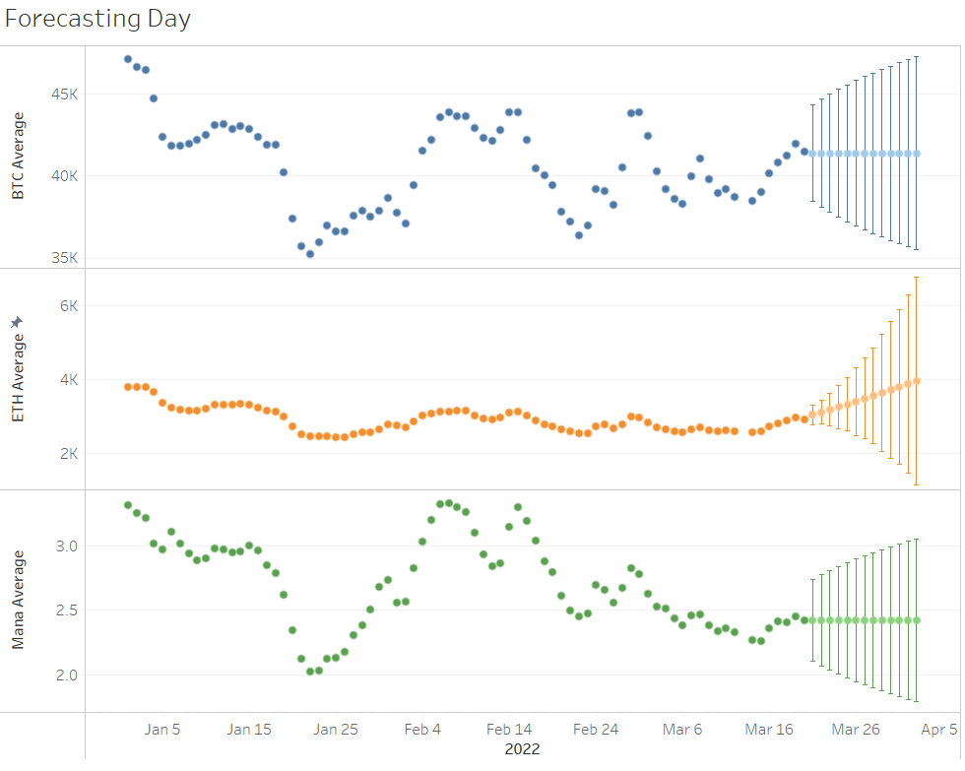
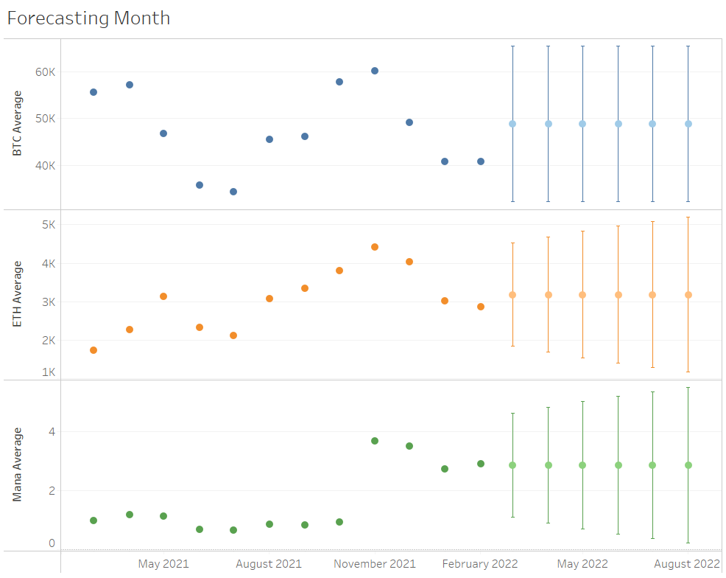
What is next for the assets?

Slide 20
Final Statements

Slide 21
When to Trade Cryptocurrencies?
Unlike traditional exchanges cryptocurrency exchanges are open 24/7
Choosing a trading strategy is tricky because the markets do not close
Trading strategy for 2022
  Buy on Monday
  Sell on Tuesday
Reasons:
  The cyclical nature of the main currencies ETH and BTC
  The weight these main coins carry
  Plus, the fluctuation metrics we explored

Slide 22
Which to Buy?
BTC and ETH are safe bets with manageable risk and excellent growth capabilities.
Mana review
Had the highest growth over the past year
Showing stability in holding its new price
The risk of this asset is still exceedingly high
Mid range of SD
Bitcoin is the market mover
Brings buyers to the table for the other assets.
BTC has some room to significantly increase its current price.
Currently on the low end of the SD
  Usually, indicative of a positive bounce.
Predictive year average sits $10,000 higher than current price
Ethereum review
Out of all assets explored Ethereum seems to be the best asset to hold in general.
Currently on the low end of the SD
Positive 6 month forecast
Well balanced, great distribution
  Currently below the average
Stable month over month movements
Has peaks and valleys but healthy recoveries

Slide 23
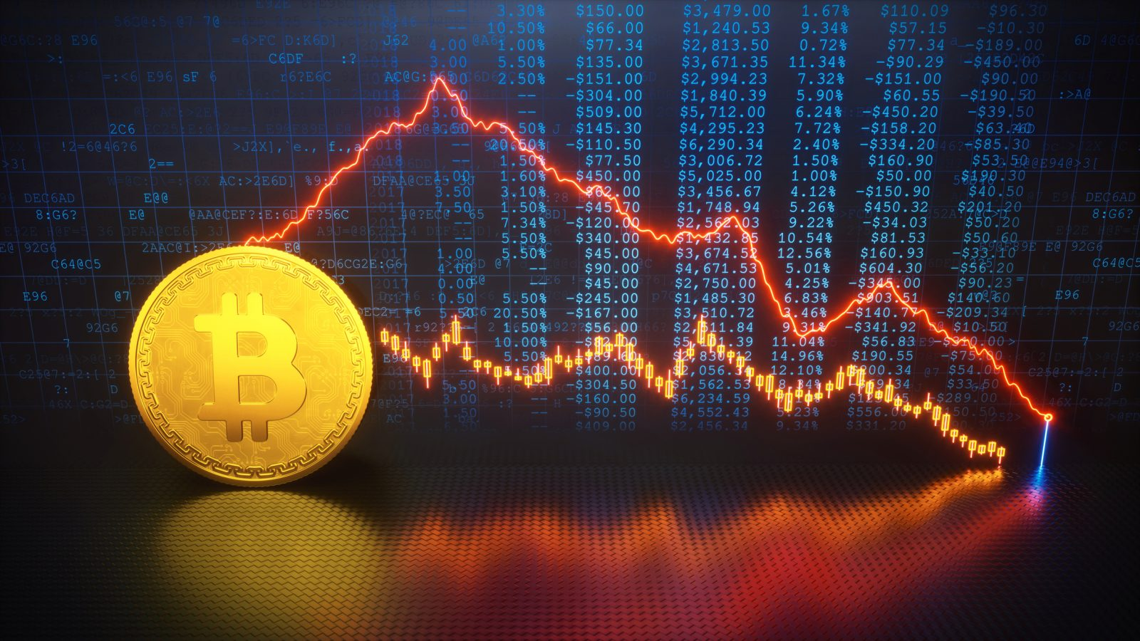
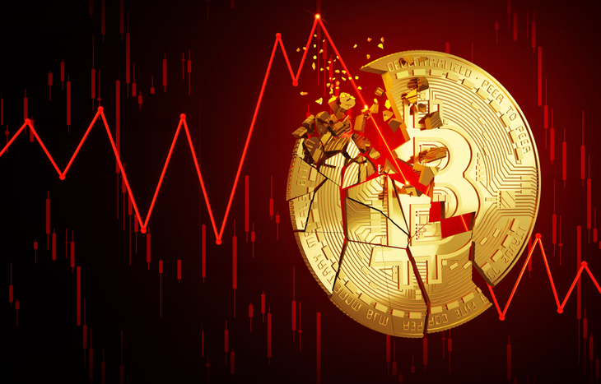
When to buy? Should it be now?
The data shows the potential for a downturn in the market in the short term
Purchasing in moderation would be a good idea as a hedge against this theory

