Slide 1

Team #7: Domino’s pizza
MGT-545
Dr. Zonghui Li
Davis College of Business, Jacksonville University
April 23, 2023
Sourayia Alsourayia, Quinton Carter, Jon Little, Silvia Rhoden, and Salena Silvaria

Slide 2
AGENDA
Company Summary & Strategy
Corporate Governance
External Environment Analysis:
  Opportunities & Threats
  Strengths & Weaknesses
Analysis of Strategic Forces
Strategic Alternatives & Recommended Strategy
Implementation
Conclusion

Slide 3
Company summary
MISSON
VISION
“Domino’s believes in doing the right thing, putting people first, creating inspired solutions, championing our customers, and growing and winning together” (Domino’s, 2022, para. 2).
“Domino’s is a purpose-inspired and performance-driven company with exceptional people who are committed to feeding the power of possible, one pizza at a time” (Domino’s, 2022, para. 1).
FINANCIAL OBJECTIVE
STRATEGIC OBJECTIVE
To continue to increase revenue while cutting internal operational costs and maintaining competitive prices to consumers by, “providing consistent service to customers and offering the cheapest delivery” (Clifford, 2019, p.2).
To continue to expand its global footprint to 25,000 stores in order to build and strengthen its market share (Clifford, 2019).

Slide 4
Company Strategy
Corporate- level: Focus on growth, quickly identify threats, and leverage strong global presence. “By clustering markets in a continual ‘fortressing’ strategy, the chain guards against third-party intrusion by shrinking delivery radiuses and improving consistency, delivery times, and lowering costs” (Klein, 2020, p. 1).
Business- level: Key areas of focus include supply chain, franchisee selection, and delivery (Trainer, 2022). Keeping quality and consumer expectations at the forefront of its strategy allows the company to defend its top position in the market and continue to strengthen its global brand presence.

Slide 5
Corporate governance
Board of Directors
Top Executives
Led by Executive Chairman, David Brandon
Purpose: The Board has the responsibility to continually monitor, assess, and advise on the effectiveness of management’s strategy, policies, and decisions (Domino’s Pizza, Inc., 2022). Overall, the goal of the board is to maximize the value of the company.
Made up of 9 members: Executive Chairman & 8 independent directors (The Wall Street Journal, 2023)
Includes various committees:
  Audit Committee
  Inclusion and Diversity Committee
  Compensation Committee
  Nominating and Corporate Governance Committee (Domino’s, 2022)
Chief Executive Officer (CEO)- responsible for steering the strategy and effectiveness of the company and serves on the board of Directors.
Chief Technology Officer (CTO)- responsible for ensuring that the company’s current technology is adequate and aligned with business needs and demand
Chief Financial Officer (CFO)- responsible for ensuring that the company has enough financial resources and proper monetary allocations to accomplish its goals
Chief Brand Officer (CBO)- responsible for monitoring the company’s overall brand presence and ensure that business vision and goals are accurately conveyed to all stakeholders.

Slide 6
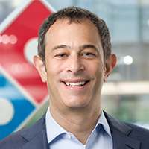
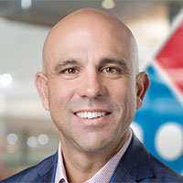

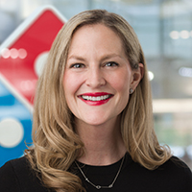




Domino’s current Top Executives
Russel Weiner
Kelly Garcia
Sandeep Reddy
Kate Trumbull
Chief Executive Officer
Chief Technology Officer
Chief Financial Officer
Chief Brand Officer

Slide 7
External environment analysis

Slide 8

PESTEL Analysis
Several factors influence the functioning of Domino:
Political factors: Government rules, labor laws, taxation
Economic factors: Inflation rates, exchange rates, unemployment
Sociocultural factors: Shifting consumer preferences, intense competition, tailored services
Technological factors: Online ordering, delivery tracking, POS systems
Environmental factors: Climate change, weather patterns, waste management
Legal factors: Intellectual property rights, advertising laws

Slide 9
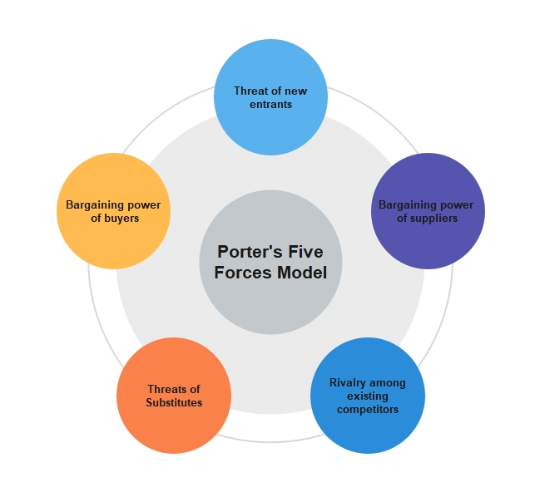
Porter’s Five Forces Analysis
Threat of New Entrants (3/5)
Bargaining Power of Buyers: (3/5)
Threat of Substitute Products or Services: (2/5)
Bargaining Power of Suppliers: (2/5)
Competitive Rivalry: (4/5)

Slide 10
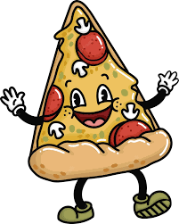
Opportunities and Threats
Driving Forces
Competitor Analysis
Key Failure Factors
Shifting consumer preferences.
Technological advancements.
Regulatory and policy changes.
Pizza Hut.
Papa John's.
Little Caesars.
Poor quality food.
Inefficient operations.
Negative publicity.
Industry Attractiveness
Key Success Factors
Strong brand.
Franchise model.
Quality and delivery speed.
Large market size globally.
Healthy profit margins.
Convenience and on-the-go eating habits.

Slide 11
internal organization analysis

Slide 12
Corporate Structure
CENTRALIZED CORPORATE STRUCTURE
CEO HOLDS ULTIMATE DECISION-MAKING POWER
Allows the company to maintain control over its operations and respond quickly to changes in the market.
Allows for clear lines of communication and decision-making.
FUNCTIONAL STRUCTURE
HIERARCHAL
Promotes specialization and expertise in each functional area.
CEO oversees all company operations, and a team of senior management executives report to them.

Slide 13
Corporate resources
1- MARKETING
2- OPERATIONS
Ability to connect with customers through various channels
Strong focus on customer experience
Well-established operational supply chain management system
Advanced technology
3- FINANCE
Its current ratio indicates Domino’s strong financial position
Domino’s price/earnings (P/E) ratio is higher than the industry average

Slide 14
SUMMARY OF FINANCIAL RATIOS AS OF DECEMBER 31, 2022
Current ratio | 1.47
Return on investment (ROI) | 58.105
Return on equity (ROE) | -10.796
Debt to equity ratio | -1.1989
Price/Earnings (P/E) | 27.11

Slide 15
Core competencies
STRONG BRAND IDENTITY
LEVERAGE TECHNOLOGY
Easily recognizable by consumers
Domino's has invested heavily in technology to improve its operations and customer experience.
INNOVATION AND CONTINUOUS IMPROVEMENT.
EFFICIENT SUPPLY CHAIN
MANAGEMENT
Helps the company stay relevant and accommodate changing consumer preferences and market trends.
Their system has allowed it to maintain consistent quality and reduce costs

Slide 16
SWOT Analysis
Strengths
Weaknesses
Supply Chain
Market Exposure & Global Postioning
Quality & Consumer Expectations
Technology
Marketing/ Brand Awareness
Lowered Margins
Lack of Diverisifcation

Slide 17
SWOT Analysis
Opportunities
Threats
Potential for Growth
Expansion
Diversification
Economic Factors
Political Factors
Competition

Slide 18
Review of vision, mission, and objectives
Rely On Technology
- Innovative Technology
- Supply Chain Management
Global Strength
-Brand Awareness
Reevaluate
- HR

Slide 19
Strategic Issues
How will Dominos address the lack of diversification? (Corporate Strategy)
Antecedents
Brand Awareness
Consequences
Global Competition

Slide 20
Strategic Issues
How will Domino’s address customers’ increasing expectations for delivery? (Business Strategy)
Antecedents
Brand Awareness
Consequences
Global Competition

Slide 21
Corporate Strategy Recommendations
Locally source the menu with ingredients that are more vegetarian/ gluten free – a “farm to table” approach.
Change the dining experience in certain stores to become a more sit-down style restaurant.

Slide 22
Business Strategy recommendations
Exclusively partner with a 3rd party delivery service
Expand UV services worldwide.

Slide 23
Implementing Strategies
DINE-IN OPTION
3RD PARTY DELIVERY PARTNERSHIPS
Shaping Corporate Structure/Culture to Fit Strategy
Covid 19 caused shift from dine-in to take-out, but that stance is now reverting
Shifting away form their established identity of a take-out brand
Improvements in restaurant environment, atmosphere will benefit customer and bottom line
Costs around décor, staffing, training in server etiquette for existing and new staff
Exercising Strategic Leadership
With the advent and wide adoption of 3rd party delivery services a shift in dominos long term strategy is inevitable
Communication is an integral part to align franchise partners, internal contributors and stakeholders
Work with franchisees is crucial since they do not own primary share of those locations
Partner identification that aligns with overall goals, vision and long-term strategy

Slide 24
Conclusion
Domino's Pizza faces a number of external opportunities and risks, such as shifting customer tastes, technology improvements, and regulatory changes. To thrive in the competitive pizza market, they must innovate, adapt to shifting fashions, and outperform their competitors. To do this, they must adopt dine-in options, provide customers with extended options, and partner with a 3rd party or in house automated vehicles for last-mile delivery.

Slide 25
References
Clifford, T. (2019). Domino’s CEO: We need 25,000 stores by 2025 to accomplish our objectives. CNBC. https://www.cnbc.com/2019/04/24/dominos-ceo-we-need- 25000-stores-by-2025-to-reach-our-goals.html
Corporate governance principles. (2022). Domino’s Pizza, INC. https://ir.dominos.com/static-files/f0115274-1371-4ab5-84fe-a4f3c003731e
Domino’s Pizza Inc. company profile & executives. (2023). The Wall Street Journal. https://www.wsj.com/market-data/quotes/DPZ/company-people
Klein, D. (2020). The strategy carrying Domino’s to new heights. QSR Magazine. https://www.qsrmagazine.com/pizza/strategy-carrying-dominos-new-heights
Trainer, D. (2022). Domino’s Pizza: Delivering a superior business model. Forbes Magazine. https://www.forbes.com/sites/greatspeculations

Slide 26
THANK YOU
Team #7 – Dominos
Sourayia Alsourayia, Quinton Carter, Jon Little, Silvia Rhoden, and Salena Silvaria

